Slide 1


Data Analysis
For Short-term rental

Slide 2
01
Profitability

Slide 3

？
Are short-term rentals more profitable?

Slide 4



Slide 6
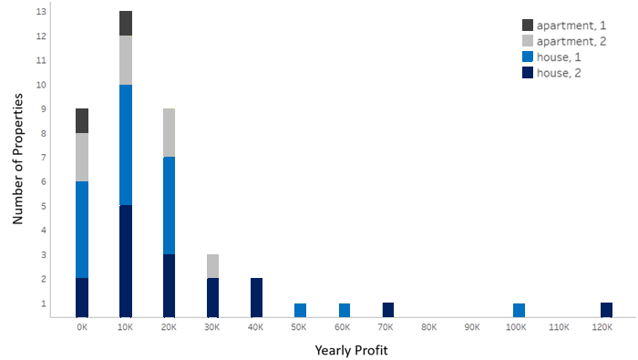
41 of 244 properties could have more than $6,000 additional profit each year

Slide 7
02
Sensitivity Analysis

Slide 8
Consideration | Worst Case Scenario | Best Case Scenario
Additional profit needed for a property to be considered | $10,000 | $5000
Cost to convert property to short-term rental | $40,000 | $20,000
Years to depreciate capital expenditures | 3 | 7
Yearly upkeep | $8,000 | $5,000
Service fees to short-term stay website | 25% | 15%
Regulatory fees | 15% | 10%
Hospitality charges | $150 | $70
Typical stay duration | 1 day | 4 days
Monthly utilities | $400 | $200
Additional Annual Profit | $173k | $2,594k

Slide 9
Most Sensitive Assumptions
Transaction Fees
Length of Stay

Slide 10
Transaction Fees

Slide 11
Average Length of Stay

Slide 12
03
Suggestion

Slide 13


Slide 14
The initial capital required to convert a long-term rental property to a short-term rental property is $30,000 (for furnishings, linens, etc.)
Under the budget of Watershed, choosing 16 most profitable properties: W46, W66, W67, W107, W108…(See White Paper)
The initial capital investment needed to implement the recommendation would be $480k (16×$30,000).

Slide 15
Profit & Cash Flow

Slide 16
Location
New York, NY
Palo Alto, CA
San Diego, CA
Austin, TX
Miami, FL

Slide 17
04
Conclusion

Slide 18

Do it!

Slide 19

The annual profit will increase almost a million dollars on budget
It will still be profitable even in the worst case

Slide 20
Thank you

